Slide 1


Chowgacha UHC & Jhenaidah Sadar Hospital model development by local initiatives
Dr. Md.Emdadul Haque
Senior National Consultant
C-J Model Replication Committee

Slide 2
Comparative data of health facilities of different country of the world
SL NO | Country | Per capita health Expenditure per year by Govt. ($) | Doctors per 10000 Population | Nurse per 10000 Population | Beds per 10000 population | Out of pocket expenditure
01 | USA | 10246 | 29 | 119 | 29 | 11.08
02 | UK | 3860 | 28 | 82 | 25 | 14.79
03 | Malaysia | 384 | 15 | 35 | 19 | 36.67
04 | Sri Lanka | 159 | 10 | 21 | 41 | 38.43
05 | India | 69 | 7. | 17 | 5.3 | 65.06
06 | Nepal | 48 | 7.5 | 31 | - | 60.41
07 | Pakistan | 45 | 9.8 | 7 | 8 | 66.49
08 | Bangladesh | 37 | 5.3 | 4 | 8 | 67
World Bank 2018

Slide 3

50 BEDED UPAZILA HEALTH COMPLEX
Chowgacha, Jessore.

Slide 4





Slide 5

Upazila Health Complex
CHOWGACHA , JESSORE.
EOC Activities : 1997- 2011 (Hospital Delivery )

Slide 6

Upazila Health Complex
CHOWGACHA , JESSORE.
EOC Activities : 2000 - 2011 (Caesarian Section)

Slide 7
Upazila Health Complex
CHOWGACHA , JESSORE.
Comparative Data of Delivery of best performing EOC center of Khulna Division in 2011
SL No | Name of institute | NVD | Vacuum Del. | V. Breech | C. Section | Total
01. | Chowgacha UHC | 3346 | 34 | 26 | 1007 | 4413
02. | Ad-din Hospital Jessore. | 1124 | 0 | 0 | 1864 | 3492
03. | Khulna Medical College Hospital | 1581 | 58 | 18 | 1356 | 3013
04. | 250 bed Hospital, Jessore | 1327 | 2 | 25 | 1498 | 2852
05. | 250 bed Hospital, Kustia | 1728 | 0 | 34 | 915 | 2677

Slide 8
Upazilla Health Complex
CHOWGACHA , JESSORE.
COMMUNITY SUPPORTED MANPOWER
TOTAL :46
  Volunteers :26
  Cleaners & guards :16
  Others :04
  The remunerations come from
  Outsourcing :25
  Service provider :21
  The amount of remuneration ranging from 200/= To 8000/=tk. Per month depending upon the style of work, which costs a total of nearly 90,ooo/=Tk per month.

Slide 9






Slide 10

100 kh¨v wewkó m`i nvmcvZvj, wSbvB`n

Slide 11
Challenges of the hospital in 2012
Insecure hospital environment.
Performance of all activities was very low.
Very limited support staff.
Receiving money from the patients by non-gov. staff.
Waste management system was poor.
Monitoring meeting was not performed regularly

Slide 12

Sadar Hospital, Jhenaidah
Bed Occupancy Rate from 1998 to 2019

Slide 13


Emergency + Out Door & Indoor Service 1998 to 2019
Emergency + Outdoor visit, Indoor (admission)

Slide 14
Operation Service (Major) 2011 to 2019
Sadar Hosital, Jhenaidah

Slide 15
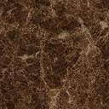
Sadar Hospital, Jhenaidah
Admitted Under 5 children in indoor from 2014 to 2019

Slide 16
Total ANC and Delivery in Jhenaidah District Hospital 2011-2019

Slide 17
Comparative data of revenue income (in Taka) from 2015 to 2019
Sadar Hospital, Jhenaidah

Slide 18
Comparative data of 4 best performing EOC Centre of Khulna division 2019

Slide 19
Community Support System in Sadar Hospital
53 manpower (Cleaner 20, Ayah & ward boy 21, Guard 6, Volunteer 3, Trolley man 3 ) is supported by the community.
MP of Jhenaidah-2 donated 14 manpower support.
Chairman of Zahedee Foundation supports 12 manpower and an intercom with a cost of nearly two lac taka.
Mayor of Jhenaidah Paurasava plays an important role in security , cleanliness, repaired the boundary wall and supports 5 man power and renovation of pediatric word and donation of a biochemistry analyzer at a cost of 1,15,000 Taka.
Retired secretary donated a generator for 24 hours OT service with a cost of nearly 33 thousand taka.
Former-chairman of Jhenidah Pourosova supports 2 manpower
Doctors of the hospital and Jhenaidah town supports 10 man power.

Slide 20




Visit to Shatkhira District Hospital and Introduction of TQM activities

Slide 21




Changes in EOC Ward
Before
After
Before
After

Slide 22








Changes in Surgery & Pediatric Word

Slide 23




Waste Management & Campus Protection
Before
After
Before
After

Slide 24




Use of direction sign, labeling of rooms, clean latrine and waste segregation
Use of direction sign
Labeling of rooms
waist segregation
Clean latrine

Slide 25




Use of color code, alignment of picture & continuous big cleaning day
Color code
Color code
Alignment of pictures

Slide 26




Innovative activities of Jhenaidah Sadar Hospital - 1
Reception room
Creation of nursing aid
Health education session
Community engagement

Slide 27




Innovative activities of Jhenaidah Sadar Hospital - 2

Slide 28




Innovative activities of Jhenaidah Sadar Hospital - 3

Slide 29




Innovative activities of Jhenaidah Sadar Hospital - 4

Slide 30




Innovative activities of Jhenaidah Sadar Hospital - 5

Slide 31




Involvement of MP, District Administrator & Mayor in Sadar Hospital

Slide 32




Involvement of district high officials in hospital activities

Slide 33




Internal Monitoring System
Meting of health improvement committee
Meting of community support group committee
QIC meeting
Monthly meeting schedule

Slide 34




Improved pediatric word by local initiative

Slide 35




Hospital Environment

Slide 36
Community support in COVID -19 Management-2
Central oxygen system - 1
High flow nasal cannula - 5
Oxygen concentrator - 3
Large oxygen cylinder - 48
C-PAP machine - 1
Pick-up caverd van - 1
Value – Nearly 52 Lac taka
Source of Donation
Prime minister’s relief fund.
MP, Jhenaidah-2.
Mayor, Jhenaidah pourosova.
Jaheedi Foundation.
Navana group.

Slide 37



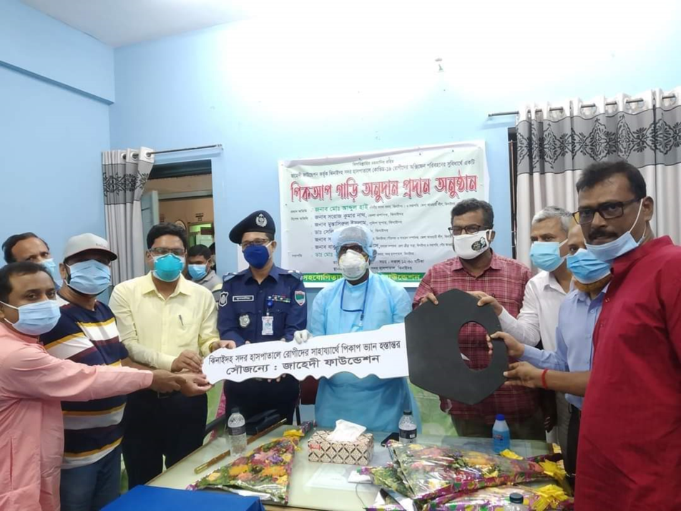
Community support in COVID -19 Management-1

Slide 38
Achievement of the Hospital
1. Active Community Participation in health service is an example in Bangladesh.
2. Improved performance of all services specially Pediatric, obstetric, operation
and outdoor service.
3. Improved Cleanliness and Beautification of Campus.
4.. The hospital is awarded 6 times from 2013 to 2018.
5. Improved Security.
6. Improved Financial Management
7. Replication of C- J Model by DGHS in 20 District hospital & 40 UHC of the country.
8. Nearly 45 laks Taka support for 6 high flow oxygen nasal cannula, central oxgen supplying system for covid patient

Slide 39

Thank You
আমাদের বাগানের ফুল
Notes:
39

Slide 40
3 best performing EmOC Hospital in Khulna division - 2017
Sadar Hospital, Jhenaidah

Slide 41
Community support in COVID -19 Management
Central oxygen system - 1 (16 Lac)
High flow nasal cannula - 5(20 Lac)
Oxygen concentrator - 3(3 Lac)
Large oxygen cylinder - 48 (3.84 Lac)
C-PAP machine - 1 (1 Lac)
Pick-up caverd van - 1 (8 Lac)

Slide 42
Donors
Prime minister’s relief fund.
MP, Jhenaidah-2.
Mayor, Jhenaidah pourosova.
Jaheedi Foundation.
Navana group.

Slide 43


Slide 44
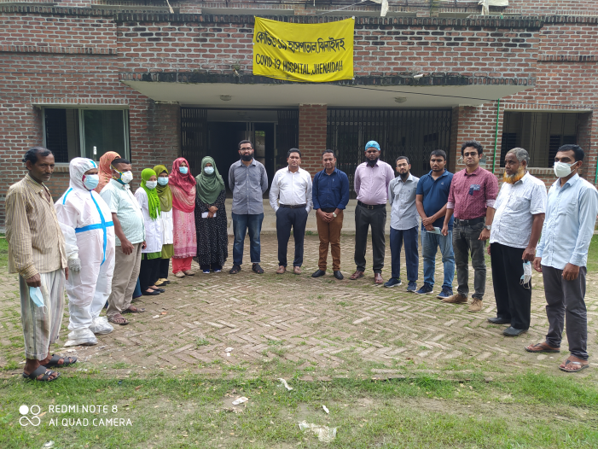
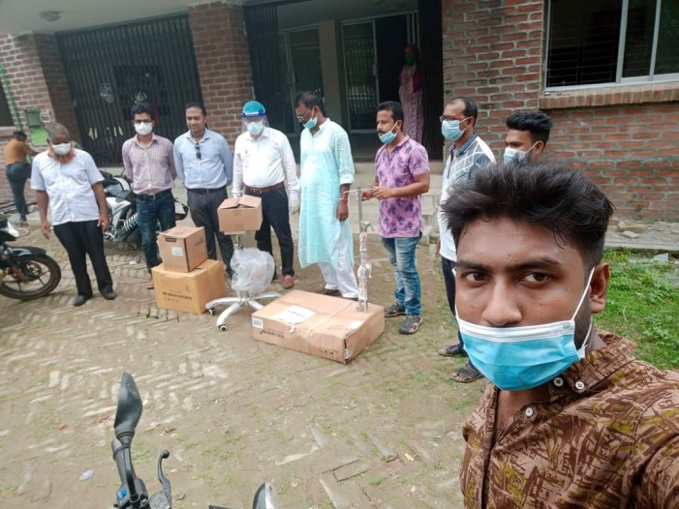
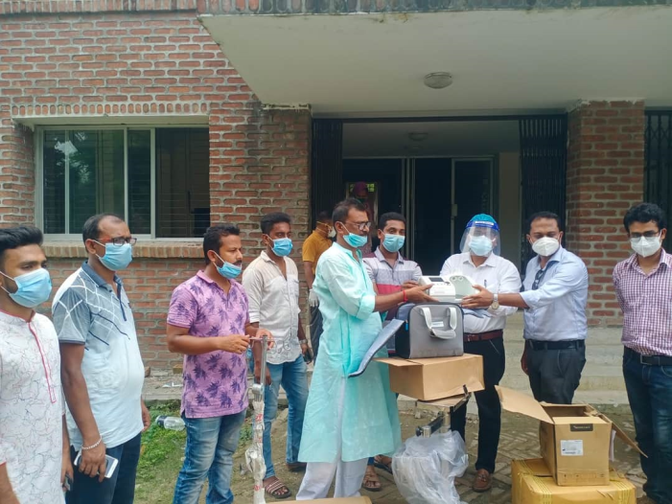
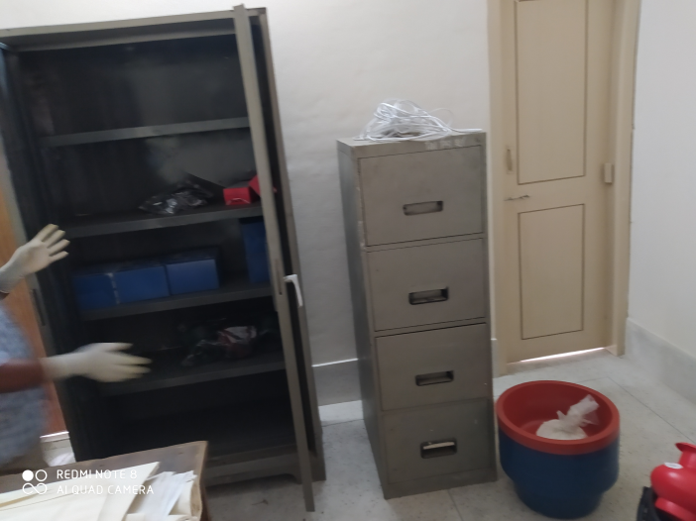

Slide 45
Upazila Health Complex
CHOWGACHA , JESSORE.
Comparative Data of Delivery of best performing EOC center of Khulna Division in 2017
SL No | Name of institute | ANC | NVD | C. Section | Total
01 | Ad-din Hospital Jessore. | 23981 | 640 | 3075 | 3715
02 | Jhenaidah Sadar Hospital | 15360 | 1839 | 1143 | 2997
03 | 250 bed Hospital, Jessore | 13152 | 1327 | 1778 | 2967
04 | Chowgacha UHC | 18650 | 2163 | 759 | 2922
05 | Khulna Medical College Hospital | 6977 | 1455 | 1228 | 2683
06 | 250 Bedded Hospital, Kushtia | 4735 | 1595 | 919 | 2514

